Slide 1
05.09 You Be the Judge
By Leanne Nelson
•Title and author of book
•Introduction
•Image of the settings
•Image of the characters
•Image of your choice
•Body paragraphs that
includes an explanation
of an interesting character,
an interesting event, the
tone, and the theme of the story
•Conclusion

Slide 2
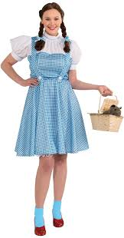
Summary
Put Your mouse on me
and click the play button

Slide 3
Title and Author of the book I read:
The Wonderful Wizard of Oz
By L Frank Baum

Slide 4
Introduction to The Wonderful Wizard Of OZ:
“Folklore, legends, myths and fairy tales have followed childhood through the ages, for every healthy youngster has a wholesome and instinctive love for stories fantastic, marvelous and manifestly unreal. The winged fairies of Grimm and Andersen have brought more happiness to childish hearts than all other human creations.
Yet the old time fairy tale, having served for generations, may now be classed as "historical" in the children's library; for the time has come for a series of newer "wonder tales" in which the stereotyped genie, dwarf and fairy are eliminated, together with all the horrible and blood-curdling incidents devised by their authors to point a fearsome moral to each tale. Modern education includes morality; therefore the modern child seeks only entertainment in its wonder tales and gladly dispenses with all disagreeable incident.
Having this thought in mind, the story of "The Wonderful Wizard of Oz" was written solely to please children of today. It aspires to being a modernized fairy tale, in which the wonderment and joy are retained and the heartaches and nightmares are left out.
L. Frank Baum
Chicago, April, 1900. ”

Slide 5
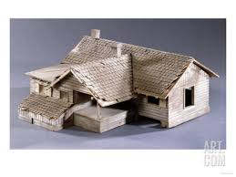
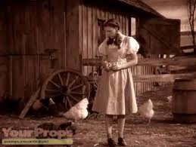
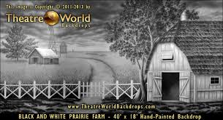
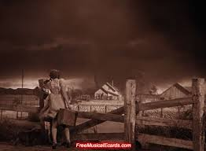
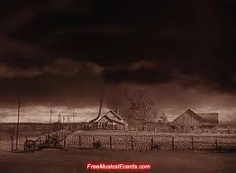
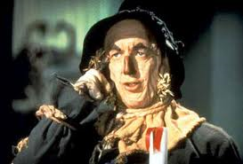
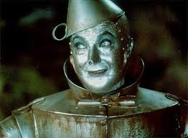
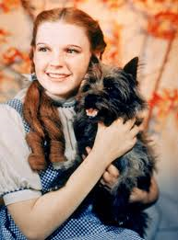
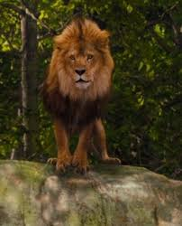
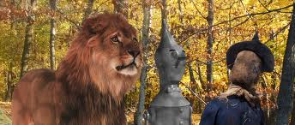
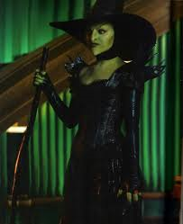
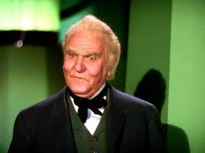
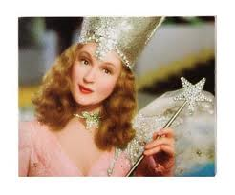
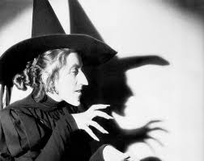
Images of the setting and Characters in the book I read:

Slide 6
All about an interesting event that occurred in the book.
The Tornado was a very main event in the book and it changed everything in Dorothy’s life. Once the tornado was formed the house flew into the air like a air balloon. This at first scared Dorothy but after a wile she calmed down and fell asleep in which Toto did the same. This Tornado had taken Dorothy to a new land which was inhabited by things normal humans would never see. It could be called imagination but that is used by everyone. The tornado had Ironically dispersed right at this new land
And while doing so killed the witch of the west.

Slide 7
Conclusion:
Dorothy gets safely back home. The friends she had made during her journey got their wishes. The evil ones were defeated. Everyone’s life returned to normal.

