Slide 1
4.03 The Birth of New Ideas Humanities and Fine Arts in the Renaissance
By Leanne Nelson

Slide 2
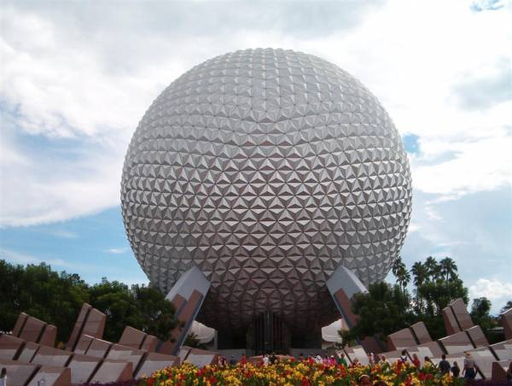
Architecture
Every day we see many buildings. Many of these buildings are based from past buildings. Like ones back in the renaissance. A particular example is The Geodesic Dome, a shape which seems ironically familiar to past historical, dome shape roofs. Hm… Odd.

Slide 3
Architecture 2
The Napel Cathedral also reminds and is a remnant of the renaissance. Its shape and form is that of renaissance buildings back in the old days. From the pillars, tall windows, even the door is like from renaissance days.

Slide 4
Art
Mona Lisa, is one of, if not the most, famous picture that dates back to the renaissance. If this painting did not represent a legacy of the renaissance, I don’t know what would.

Slide 5
Inventions
The parachute was made by Leonardo de Vinci. He was well known for his art, but if you look in the emergency procedure of exiting a plane, his inventions are indeed important. As well as well known. Unless you like the idea of being crippled from hitting the ground too fast.

Slide 6
Literature
Shakespeare’s plays definitely are an artifact of the renaissance in the modern day. To this day his plays are used to educate kids.

